Slide 1



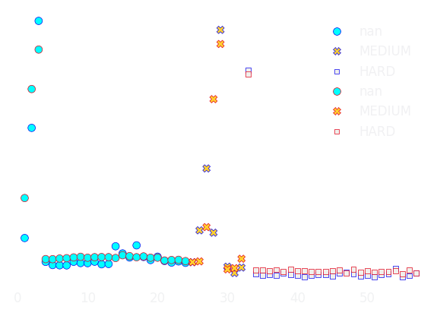
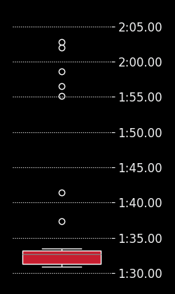
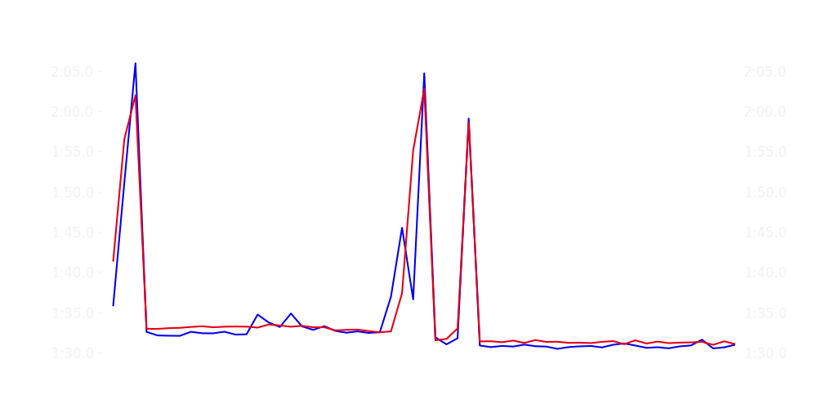
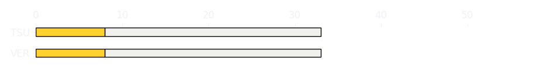
Miami GP Race
Driver
Race Time
Race Time
Driver
Max Verstappen
1:27:55.874
1:28:19.814
Yuki Tsunoda
Avg Lap Time
1:32.096
IQR
Gap
Gap
IQR
Avg Lap Time
2.002 s
-29.478 s
+29.478 s
1.872 s
1:32.673
Race Comparaison
Race Comparaison
Lap Advantage
45/57
Position
4
Safety Car Lap
0/57
Position
10
Lap Advantage
12/57
Lap Time Per Lap
Lap Time Per Lap
Tyre Strategy
Total Pit Stop Time
00:22.501 s
Pit Stops
1
Pit Stops
1
Total Pit Stop Time
00:22.560 s
Tyre Strategy

Slide 2

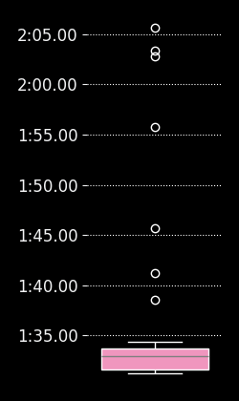
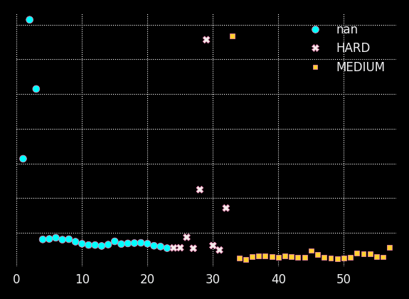

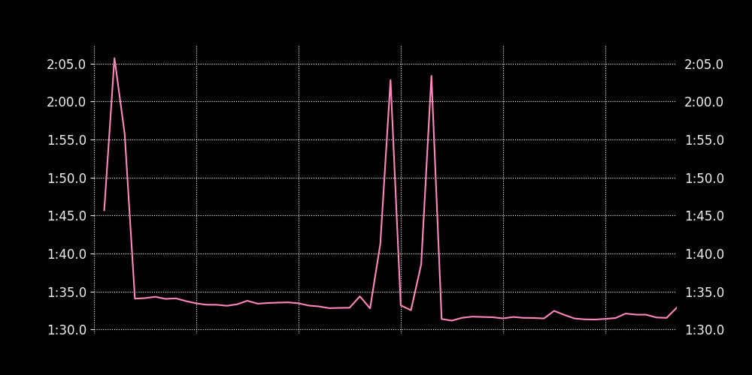
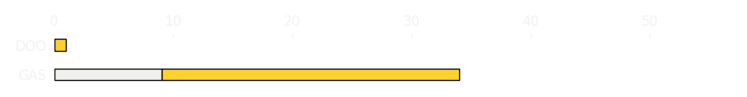
Miami GP Race
Driver
Race Time
Race Time
Driver
Pierre Gasly
1:28:36.558
0
Jack Doohan
Avg Lap Time
1:32.874
IQR
Gap
Gap
IQR
Avg Lap Time
2.125 s
-56 laps
+56 laps
0
0
Race Comparaison
Race Comparaison
Lap Advantage
56/56
Position
13
Safety Car Lap
0/56
Position
DNF
Lap Advantage
0/56
Lap Time Per Lap
Lap Time Per Lap
Tyre Strategy
Total Pit Stop Time
00:22.060 s
Pit Stops
1
Pit Stops
0
Total Pit Stop Time
0:00:00
Tyre Strategy

Slide 3


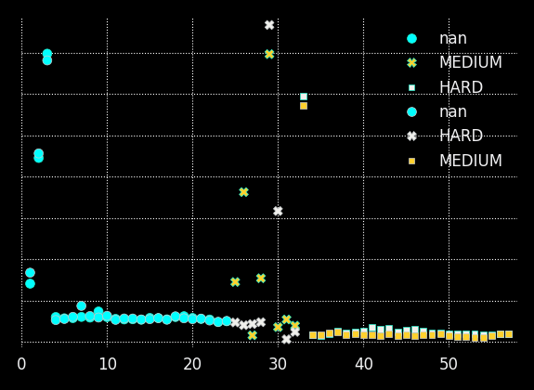
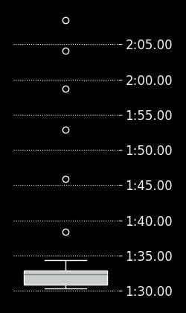
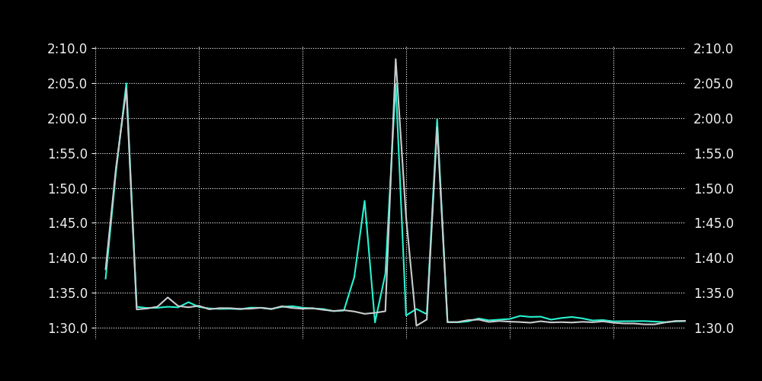
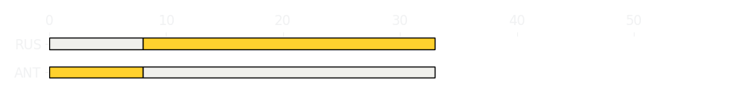
Miami GP Race
Driver
Race Time
Race Time
Driver
Kimi Antonelli
1:28:10.239
1:27:51.053
George Russell
Avg Lap Time
1:32.500
IQR
Gap
Gap
IQR
Avg Lap Time
1.814 s
+17.858 s
-17.858 s
1.977 s
1:32.260
Race Comparaison
Race Comparaison
Lap Advantage
21/57
Position
6
Safety Car Lap
0/57
Position
3
Lap Advantage
36/57
Lap Time Per Lap
Lap Time Per Lap
Tyre Strategy
Total Pit Stop Time
00:24.383 s
Pit Stops
1
Pit Stops
1
Total Pit Stop Time
00:24.257 s
Tyre Strategy

Slide 4


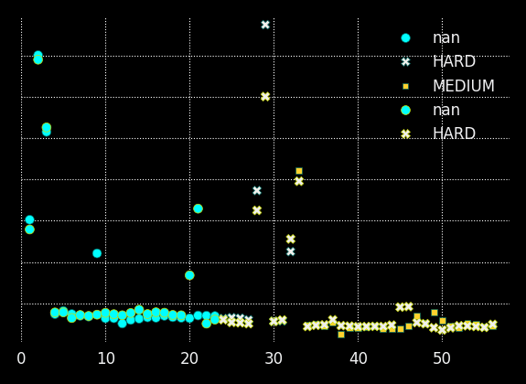
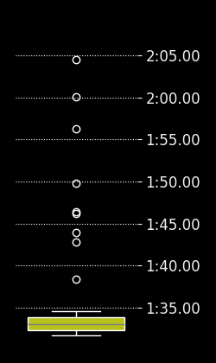
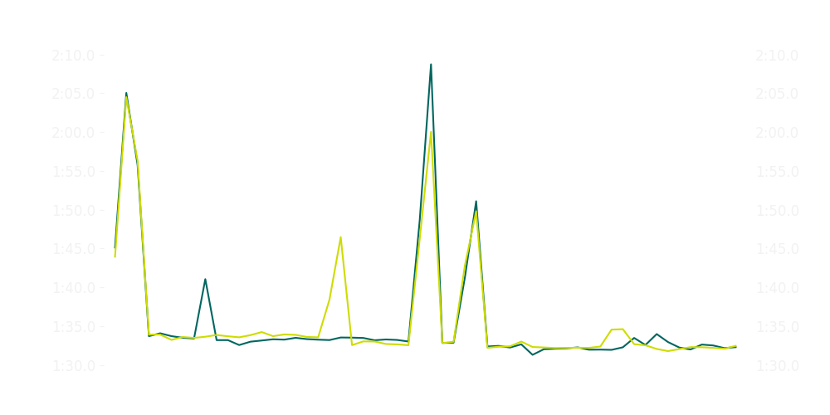
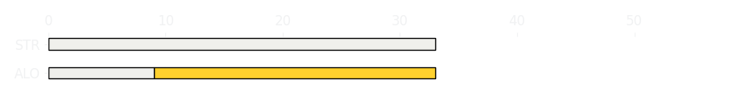
Miami GP Race
Driver
Race Time
Race Time
Driver
Fernando Alonso
1:27:27.653
1:27:33.015
Lance Stroll
Avg Lap Time
1:33.165
IQR
Gap
Gap
IQR
Avg Lap Time
1.16 s
-4.183 s
+4.183 s
1.569 s
1:33.011
Race Comparaison
Race Comparaison
Lap Advantage
30/56
Position
15
Safety Car Lap
0/56
Position
16
Lap Advantage
26/56
Lap Time Per Lap
Lap Time Per Lap
Tyre Strategy
Total Pit Stop Time
00:23.602 s
Pit Stops
1
Pit Stops
1
Total Pit Stop Time
00:22.317 s
Tyre Strategy

Slide 5

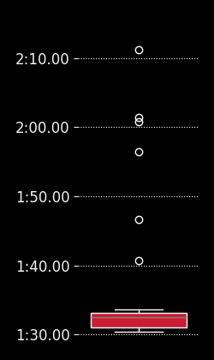
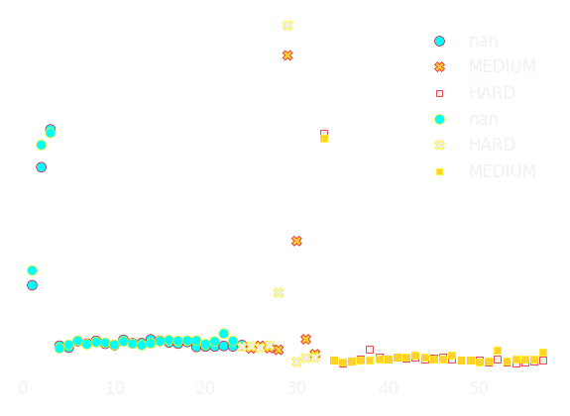
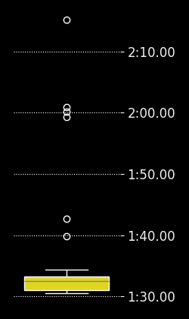
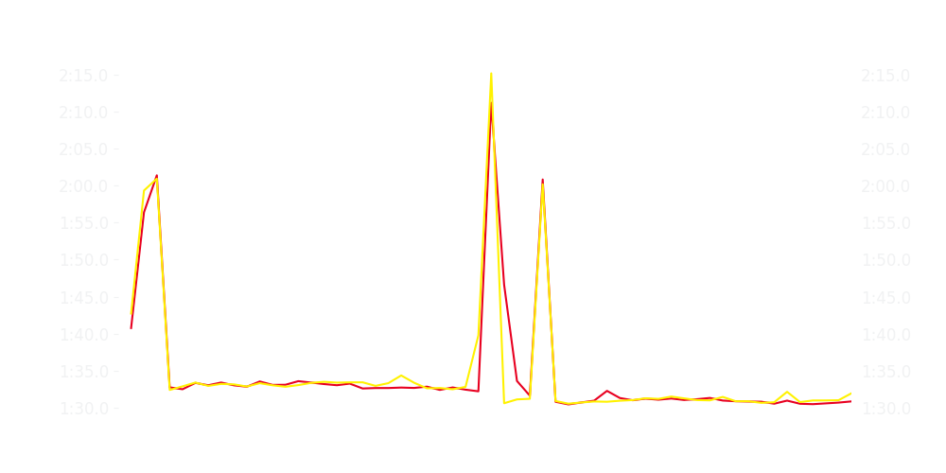
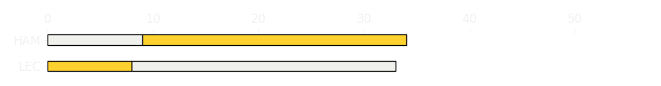
Miami GP Race
Driver
Race Time
Race Time
Driver
Charles Leclerc
1:28:08.062
1:28:09.256
Lewis Hamilton
Avg Lap Time
1:32.480
IQR
Gap
Gap
IQR
Avg Lap Time
2.118 s
-3.15 s
+3.15 s
2.321 s
1:32.457
Race Comparaison
Race Comparaison
Lap Advantage
35/57
Position
7
Safety Car Lap
0/57
Position
8
Lap Advantage
22/57
Lap Time Per Lap
Lap Time Per Lap
Tyre Strategy
Total Pit Stop Time
00:22.183 s
Pit Stops
1
Pit Stops
1
Total Pit Stop Time
00:23.104 s
Tyre Strategy

Slide 6


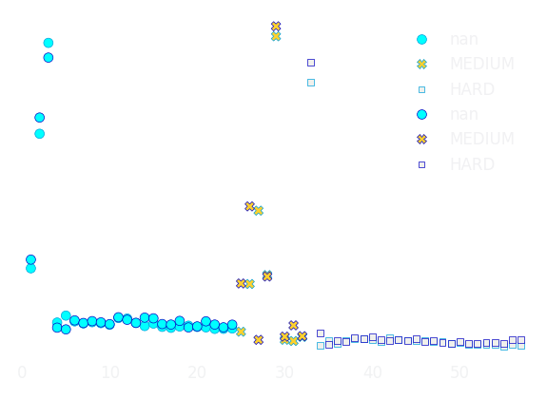

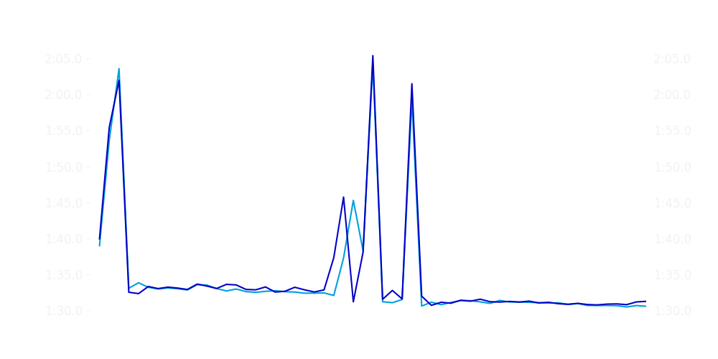

Miami GP Race
Driver
Race Time
Race Time
Driver
Alexander Albon
1:28:00.872
1:28:12.433
Carlos Sainz
Avg Lap Time
1:32.390
IQR
Gap
Gap
IQR
Avg Lap Time
1.96 s
-12.51 s
+12.51 s
2.071 s
1:32.521
Race Comparaison
Race Comparaison
Lap Advantage
43/57
Position
5
Safety Car Lap
0/57
Position
9
Lap Advantage
14/57
Lap Time Per Lap
Lap Time Per Lap
Tyre Strategy
Total Pit Stop Time
00:21.906 s
Pit Stops
1
Pit Stops
1
Total Pit Stop Time
00:22.415 s
Tyre Strategy

Slide 7


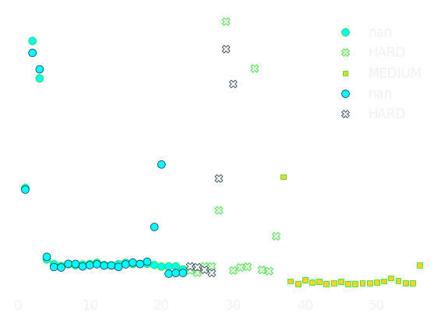

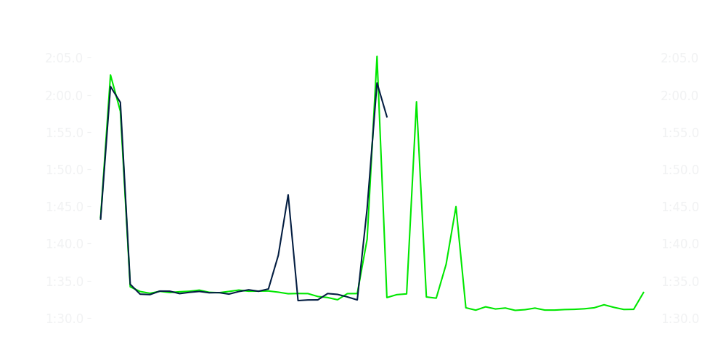
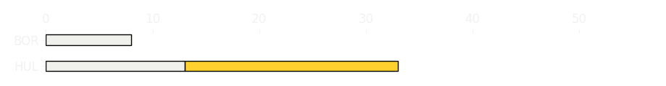
Miami GP Race
Driver
Race Time
Race Time
Driver
Nico Hulkenberg
1:27:09.436
0:47:20.375
Gabriel Bortoleto
Avg Lap Time
1:33.269
IQR
Gap
Gap
IQR
Avg Lap Time
2.221 s
-25 laps
+25 laps
4.242 s
1:33.554
Race Comparaison
Race Comparaison
Lap Advantage
38/55
Position
14
Safety Car Lap
0/55
Position
17
Lap Advantage
17/55
Lap Time Per Lap
Lap Time Per Lap
Tyre Strategy
Total Pit Stop Time
00:22.108 s
Pit Stops
1
Pit Stops
1
Total Pit Stop Time
00:22.188 s
Tyre Strategy

Slide 8


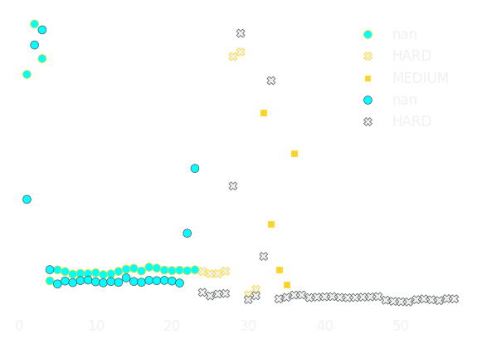

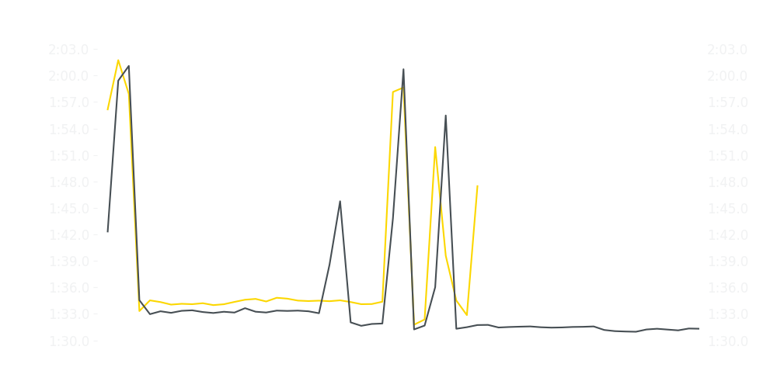
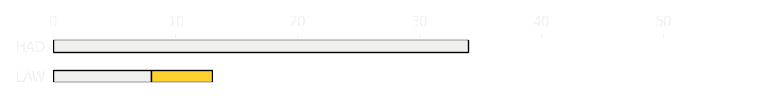
Miami GP Race
Driver
Race Time
Race Time
Driver
Liam Lawson
0:57:10.547
1:28:24.064
Isack Hadjar
Avg Lap Time
1:34.440
IQR
Gap
Gap
IQR
Avg Lap Time
0.639 s
+21 laps
-21 laps
1.883 s
1:31.902
Race Comparaison
Race Comparaison
Lap Advantage
6/57
Position
17
Safety Car Lap
0/57
Position
11
Lap Advantage
51/57
Lap Time Per Lap
Lap Time Per Lap
Tyre Strategy
Total Pit Stop Time
00:22.439 s
Pit Stops
1
Pit Stops
1
Total Pit Stop Time
00:22.115 s
Tyre Strategy

Slide 9


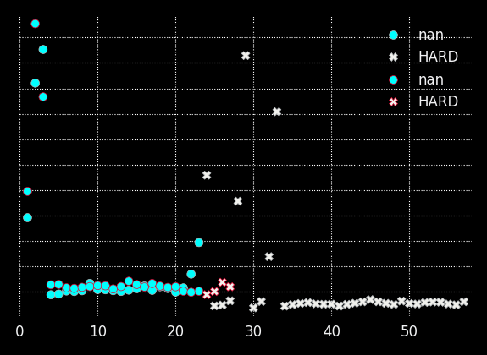
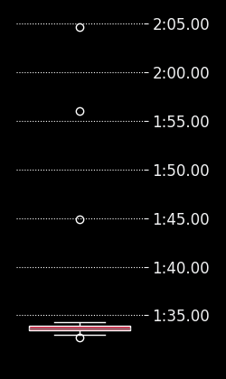
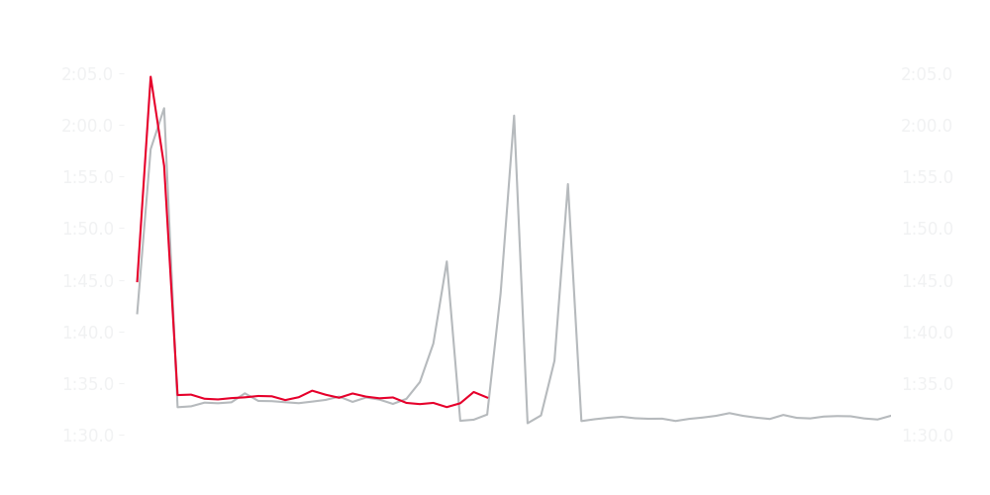
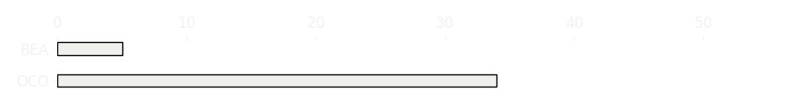
Miami GP Race
Driver
Race Time
Race Time
Driver
Esteban Ocon
1:28:32.038
0:41:26.123
Ollie Bearman
Avg Lap Time
1:32.099
IQR
Gap
Gap
IQR
Avg Lap Time
1.764 s
-29 laps
+29 laps
0.427 s
1:33.626
Race Comparaison
Race Comparaison
Lap Advantage
49/56
Position
12
Safety Car Lap
0/56
Position
13
Lap Advantage
7/56
Lap Time Per Lap
Lap Time Per Lap
Tyre Strategy
Total Pit Stop Time
00:23.162 s
Pit Stops
1
Pit Stops
0
Total Pit Stop Time
0:00:00
Tyre Strategy

Slide 10


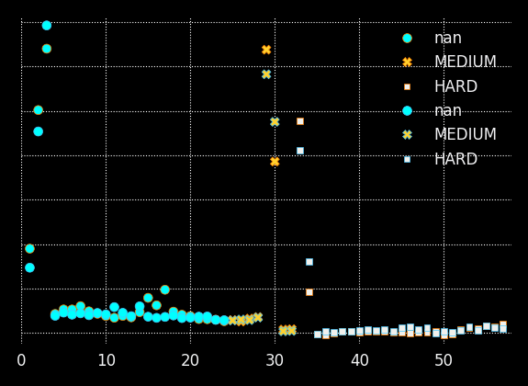

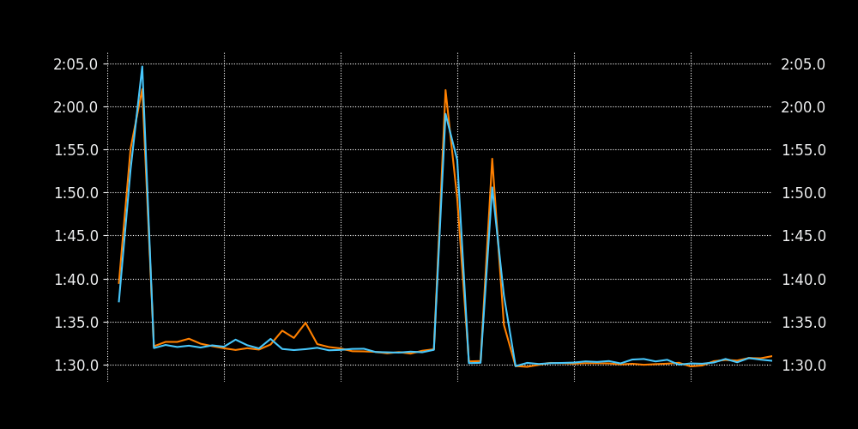

Miami GP Race
Driver
Race Time
Race Time
Driver
Lando Norris
1:27:16.940
1:27:14.452
Oscar Piastri
Avg Lap Time
1:31.478
IQR
Gap
Gap
IQR
Avg Lap Time
2.216 s
+04.630 s
-04.630 s
1.74 s
1:31.465
Race Comparaison
Race Comparaison
Lap Advantage
28/57
Position
2
Safety Car Lap
0/57
Position
1
Lap Advantage
29/57
Lap Time Per Lap
Lap Time Per Lap
Tyre Strategy
Total Pit Stop Time
00:22.044 s
Pit Stops
1
Pit Stops
1
Total Pit Stop Time
00:22.106 s
Tyre Strategy

